Slide 1
MIN() FUNCTION
Returns the smallest value of the selected column.
Syntax
SELECT MIN(column_name) FROM table_name WHERE condition;
Example:
SELECT MIN(Age) AS Youngest FROM Student;
Youngest 16
Student ID | Student Name | Address | City | Age
111 | Arjun | 124, brown street | Redmond | 18
112 | Alfred | 489, avatar road | Springdale | 17
113 | Robin | 531, Leicester | Thomasville | 18
114 | Rasool | 742, red street | Racine | 19
115 | Ibrahim | 128, manali street | Newyork | 16
116 | Ratan | Red fort | New Delhi | 18

Slide 2
MAX() FUNCTION
Returns the largest value of the selected column.
Syntax
SELECT MAX(column_name) FROM table_name WHERE condition;
Example:
SELECT MAX(Age) AS Oldest FROM Student;
Oldest 19
Student ID | Student Name | Address | City | Age
111 | Arjun | 124, brown street | Redmond | 18
112 | Alfred | 489, avatar road | Springdale | 17
113 | Robin | 531, Leicester | Thomasville | 18
114 | Rasool | 742, red street | Racine | 19
115 | Ibrahim | 128, manali street | Newyork | 16
116 | Ratan | Red fort | New Delhi | 18

Slide 3
COUNT()
This function returns the number of rows that matches the specified condition.
Syntax
SELECT COUNT(column_name) FROM table_name WHERE condition;
Example

Slide 4
AVG()
This function returns the average value of a numeric column.
Syntax
SELECT AVG(column_name) FROM table_name WHERE condition;

Slide 5
SUM()
This function returns the total sum of numeric column
Syntax
SELECT SUM(column_name) FROM table_name WHERE condition;
Example:

Slide 6
LIKE
LIKE operator is used in a WHERE clause to search for a specified pattern in a column.
(%) percent is used as multiple character representation and ( _ ) underscore represents single character with LIKE operator.
Syntax
SELECT column1, column2,…FROM table_name WHERE column LIKE pattern;
Example:
SELECT * FROM Student WHERE Student Name LIKE ‘r%’;

Slide 7
Student ID | Student Name | Address | City | Age
111 | Arjun | 124, brown street | Redmond | 18
112 | Alfred | 489, avatar road | Springdale | 17
113 | Robin | 531, Leicester | Thomasville | 18
114 | Rasool | 742, red street | Racine | 19
115 | Ibrahim | 128, manali street | New York | 16
116 | Ratan | Red fort | New Delhi | 18
Student ID | Student Name | Address | City | Age
113 | Robin | 531, Leicester | Thomasville | 18
114 | Rasool | 742, red street | Racine | 19
116 | Ratan | Red fort | New Delhi | 18

Slide 8
SELECT * FROM Student WHERE Student Name LIKE '_a%';
Student ID | Student Name | Address | City | Age
111 | Arjun | 124, brown street | Redmond | 18
112 | Alfred | 489, avatar road | Springdale | 17
113 | Robin | 531, Leicester | Thomasville | 18
114 | Rasool | 742, red street | Racine | 19
115 | Ibrahim | 128, manali street | Newyork | 16
116 | Ratan | Red fort | New Delhi | 18
Student ID | Student Name | Address | City | Age
114 | Rasool | 742, red street | Racine | 19
116 | Ratan | Red fort | New Delhi | 18

Slide 9
SELECT * FROM Student WHERE Student Name LIKE ‘%n’;
Student ID | Student Name | Address | City | Age
111 | Arjun | 124, brown street | Redmond | 18
112 | Alfred | 489, avatar road | Springdale | 17
113 | Robin | 531, Leicester | Thomasville | 18
114 | Rasool | 742, red street | Racine | 19
115 | Ibrahim | 128, manali street | New York | 16
116 | Ratan | Red fort | New Delhi | 18
Student ID | Student Name | Address | City | Age
111 | Arjun | 124, brown street | Redmond | 18
113 | Robin | 531, Leicester | Thomasville | 18
116 | Ratan | Red fort | New Delhi | 18

Slide 10
BETWEEN
BETWEEN operator selects the value within a given range.
Values can be numbers , text and dates.
Syntax:
SELECT column_name(s) FROM table_name WHERE column_name BETWEEN value1 AND value2;
Example:
SELECT * FROM Student WHERE age BETWEEN 16 AND 18;

Slide 11
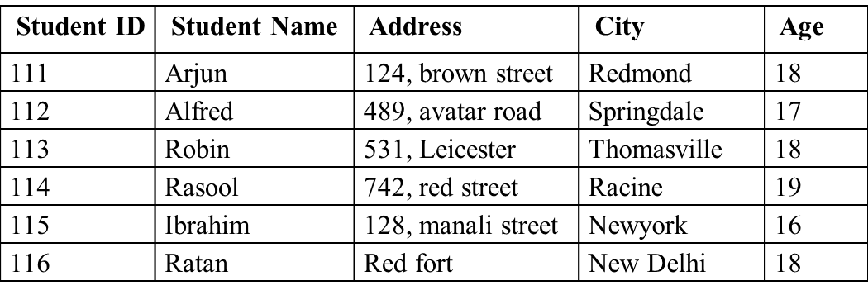

Student ID | Student Name | Address | City | Age
111 | Arjun | 124, brown street | Redmond | 18
112 | Alfred | 489, avatar road | Springdale | 17
113 | Robin | 531, Leicester | Thomasville | 18
115 | Ibrahim | 128, manali street | Newyork | 16
116 | Ratan | Red fort | New Delhi | 18

Slide 12
ALIASES
ALIASES are used to give a table or a column in a table, a temporary name.
It is used to make column name readable and exists only for duration of the query.
Syntax: ALIAS column syntax:
SELECT column_name AS alias_name FROM table_name;
Example:
SELECT Student ID AS ID, Student Name AS Student FROM Student;

Slide 13
ID | Student
111 | Arjun
112 | Alfred
113 | Robin
115 | Ibrahim
116 | Ratan

Slide 14
UNION
UNION operator is used to combine the result set of two or more SELECT statements.
SELECT statement with UNION must have same number of columns and column must be of similar data types.
Columns in each SELECT statement must also be in same order.
Syntax:
SELECT column_name(s) FROM table1 UNION SELECT column_name(s) FROM table2;
Example:
SELECT city FROM Student UNION SELECT city FROM Staff ORDER BY city;

Slide 15

Student ID | Student Name | Address | City
111 | Arjun | 124, brown street | Redmond
112 | Alfred | 489, avatar road | Springdale
113 | Robin | 531, Leicester | Thomasville
114 | Rasool | 742, red street | Kozhikode
115 | Ibrahim | 128, manali street | New York
116 | Ratan | Red fort | New Delhi
117 | Hafeez | 541, benedict street | Anna nagar
118 | Shaw | 224, Nehru street | Velachery
119 | Yadav | 334, natesan street | Madurai
120 | Labuschenge | 684, demonte street | New York
121 | Usman | 128, kk street | Kozhikode
122 | Babar | 145, jj street | New Delhi
City
Anna Nagar
Kozhikode
Madurai
New Delhi
New York
Redmond
Springdale
Thomasville
Velachery

Slide 16
UNION ALL
Syntax
SELECT column_name(s) FROM table1 UNION ALL SELECT column_name(s) FROM table2;
Example:
SELECT city FROM Student UNION ALL SELECT city FROM Staff ORDER BY city;
Duplicate values are allowed in UNION ALL

Slide 17
Same values are repeated in UNION ALL
Student ID | Student Name | Address | City
111 | Arjun | 124, brown street | Redmond
112 | Alfred | 489, avatar road | Springdale
113 | Robin | 531, Leicester | Thomasville
114 | Rasool | 742, red street | Kozhikode
115 | Ibrahim | 128, manali street | New York
116 | Ratan | Red fort | New Delhi
117 | Hafeez | 541, benedict street | Anna nagar
118 | Shaw | 224, Nehru street | Velachery
119 | Yadav | 334, natesan street | Madurai
120 | Labuschenge | 684, demonte street | New York
121 | Usman | 128, kk street | Kozhikode
122 | Babar | 145, jj street | New Delhi
City
Anna nagar
Kozhikode
Kozhikode
Madurai
New Delhi
New Delhi
New York
New York
Redmond
Springdale
Thomasville
Velachery

Slide 18
GROUP BY
GROUP BY statement is used with aggregate functions (COUNT, MAX,MIN, AVG,SUM) to group the result set by one or more columns.
Syntax
SELECT column_name(s) FROM table_name WHERE condition GROUP BY column_name(s) ORDER BY column_name(s);
Example:
SELECT COUNT(Student ID), City FROM Student
GROUP BY City;

Slide 19
Student ID | Student Name | Address | City
111 | Arjun | 124, brown street | Redmond
112 | Alfred | 489, avatar road | Springdale
113 | Robin | 531, Leicester | Thomasville
114 | Rasool | 742, red street | Kozhikode
115 | Ibrahim | 128, manali street | New York
116 | Ratan | Red fort | New Delhi
117 | Hafeez | 541, benedict street | Anna nagar
118 | Shaw | 224, Nehru street | Velachery
119 | Yadav | 334, natesan street | Madurai
120 | Labuschenge | 684, demonte street | New York
121 | Usman | 128, kk street | Kozhikode
122 | Babar | 145, jj street | New Delhi
1 | Anna nagar
2 | Kozhikode
1 | Madurai
2 | New Delhi
2 | New York
1 | Redmond
1 | Springdale
1 | Thomasville
1 | Velachery

